Slide 1
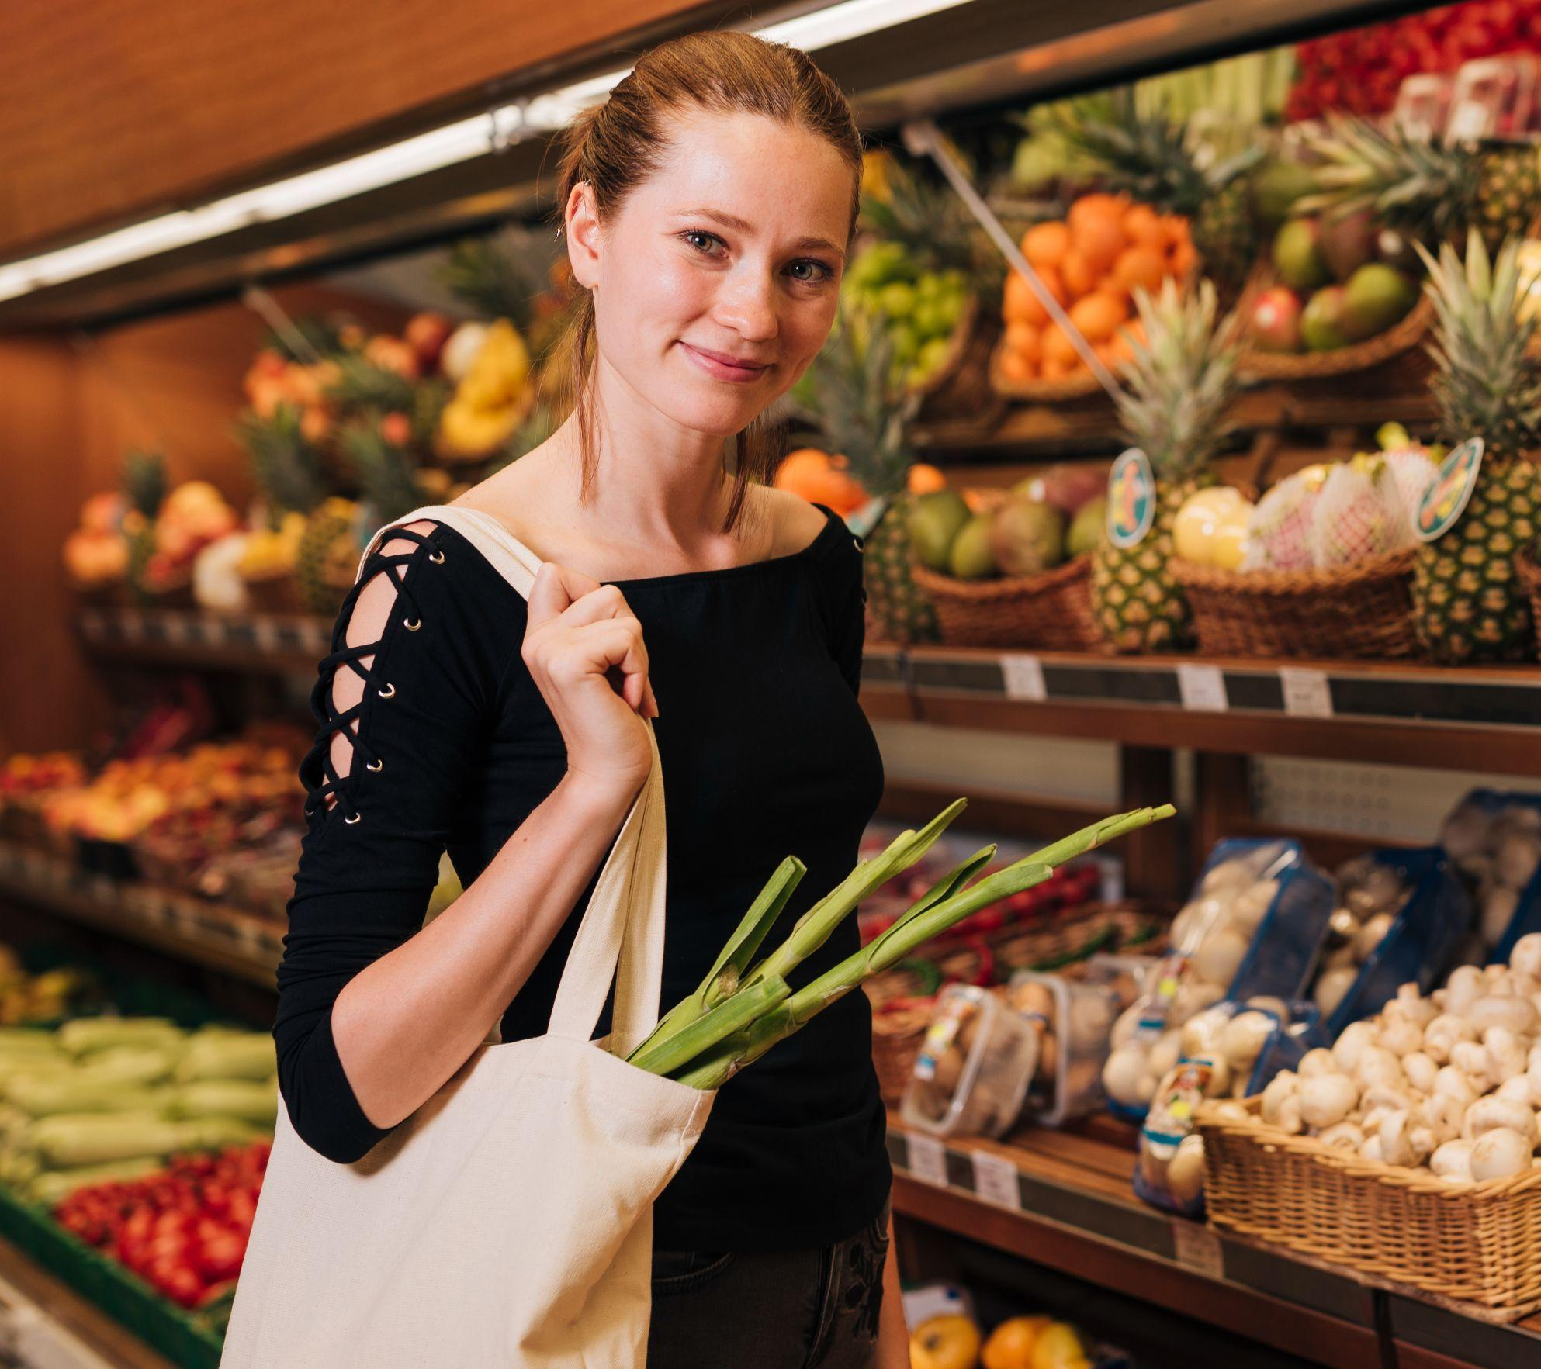
FOOD APP Yummy Joy
The Mobile App that will help people buy groceries at a cheaper price and fight against food waste

Slide 2
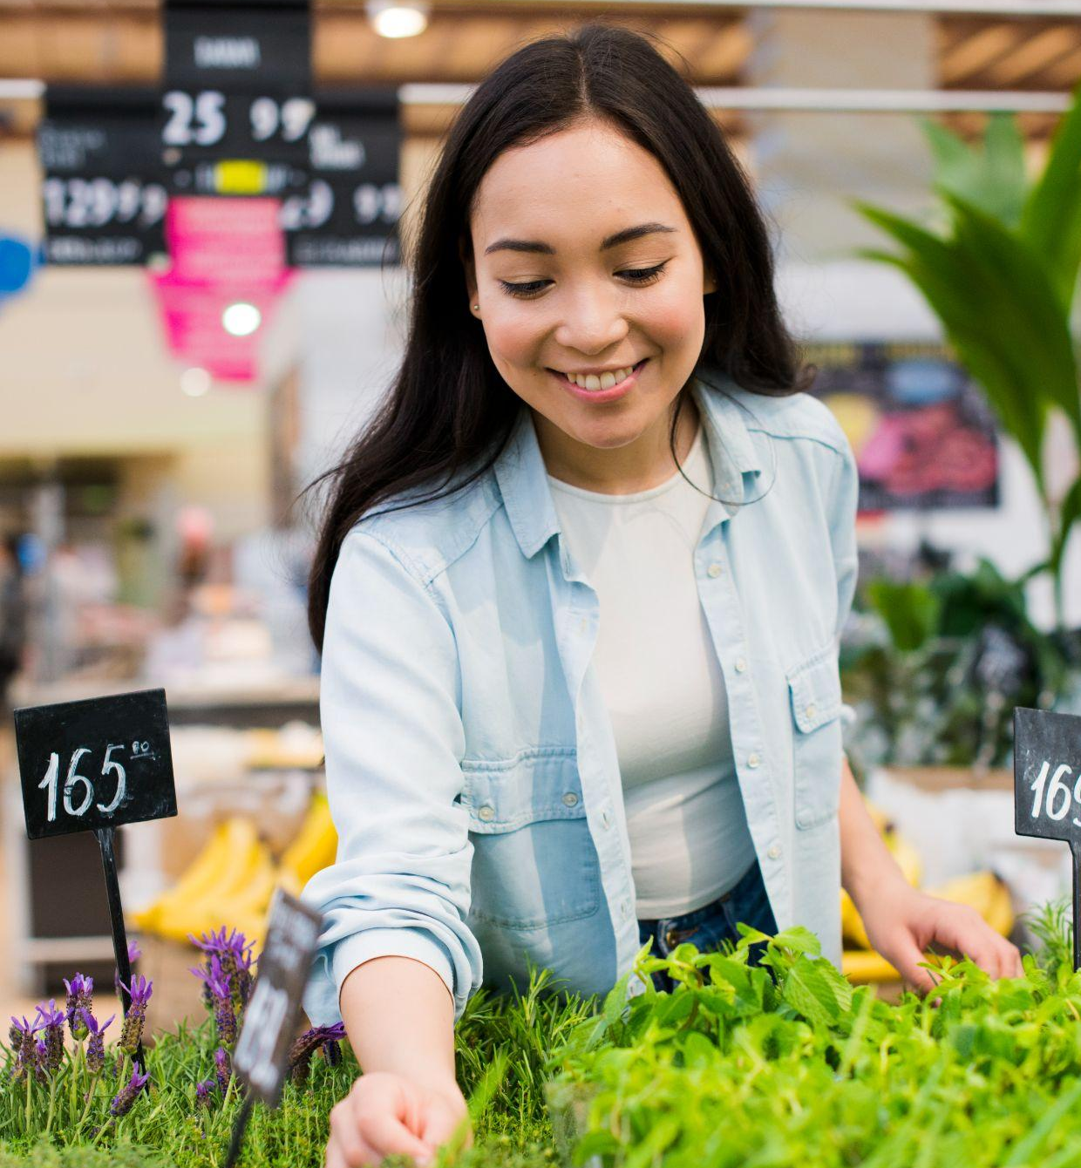
ABOUT US
Gabriel K.S.P - My brother and I were raised by a single mother, and we received free lunches during middle and high school.
Andres Ramirez – Coming from Venezuela, a now poor country, my family and I had to skip some meals to save up for the next meal.
Hasan Khan – family grew in the poorer part of Montreal, helped my dad open a food bank to give back.
Sebastian Valcarcel – During my first year in Canada, my family and I had to rely on food banks and deals to feed ourselves.
Eraste Boko – Coming from Benin Republic that is a poor country in West Africa, I grew up in a community where many people could barely afford one meal per day.

Slide 3
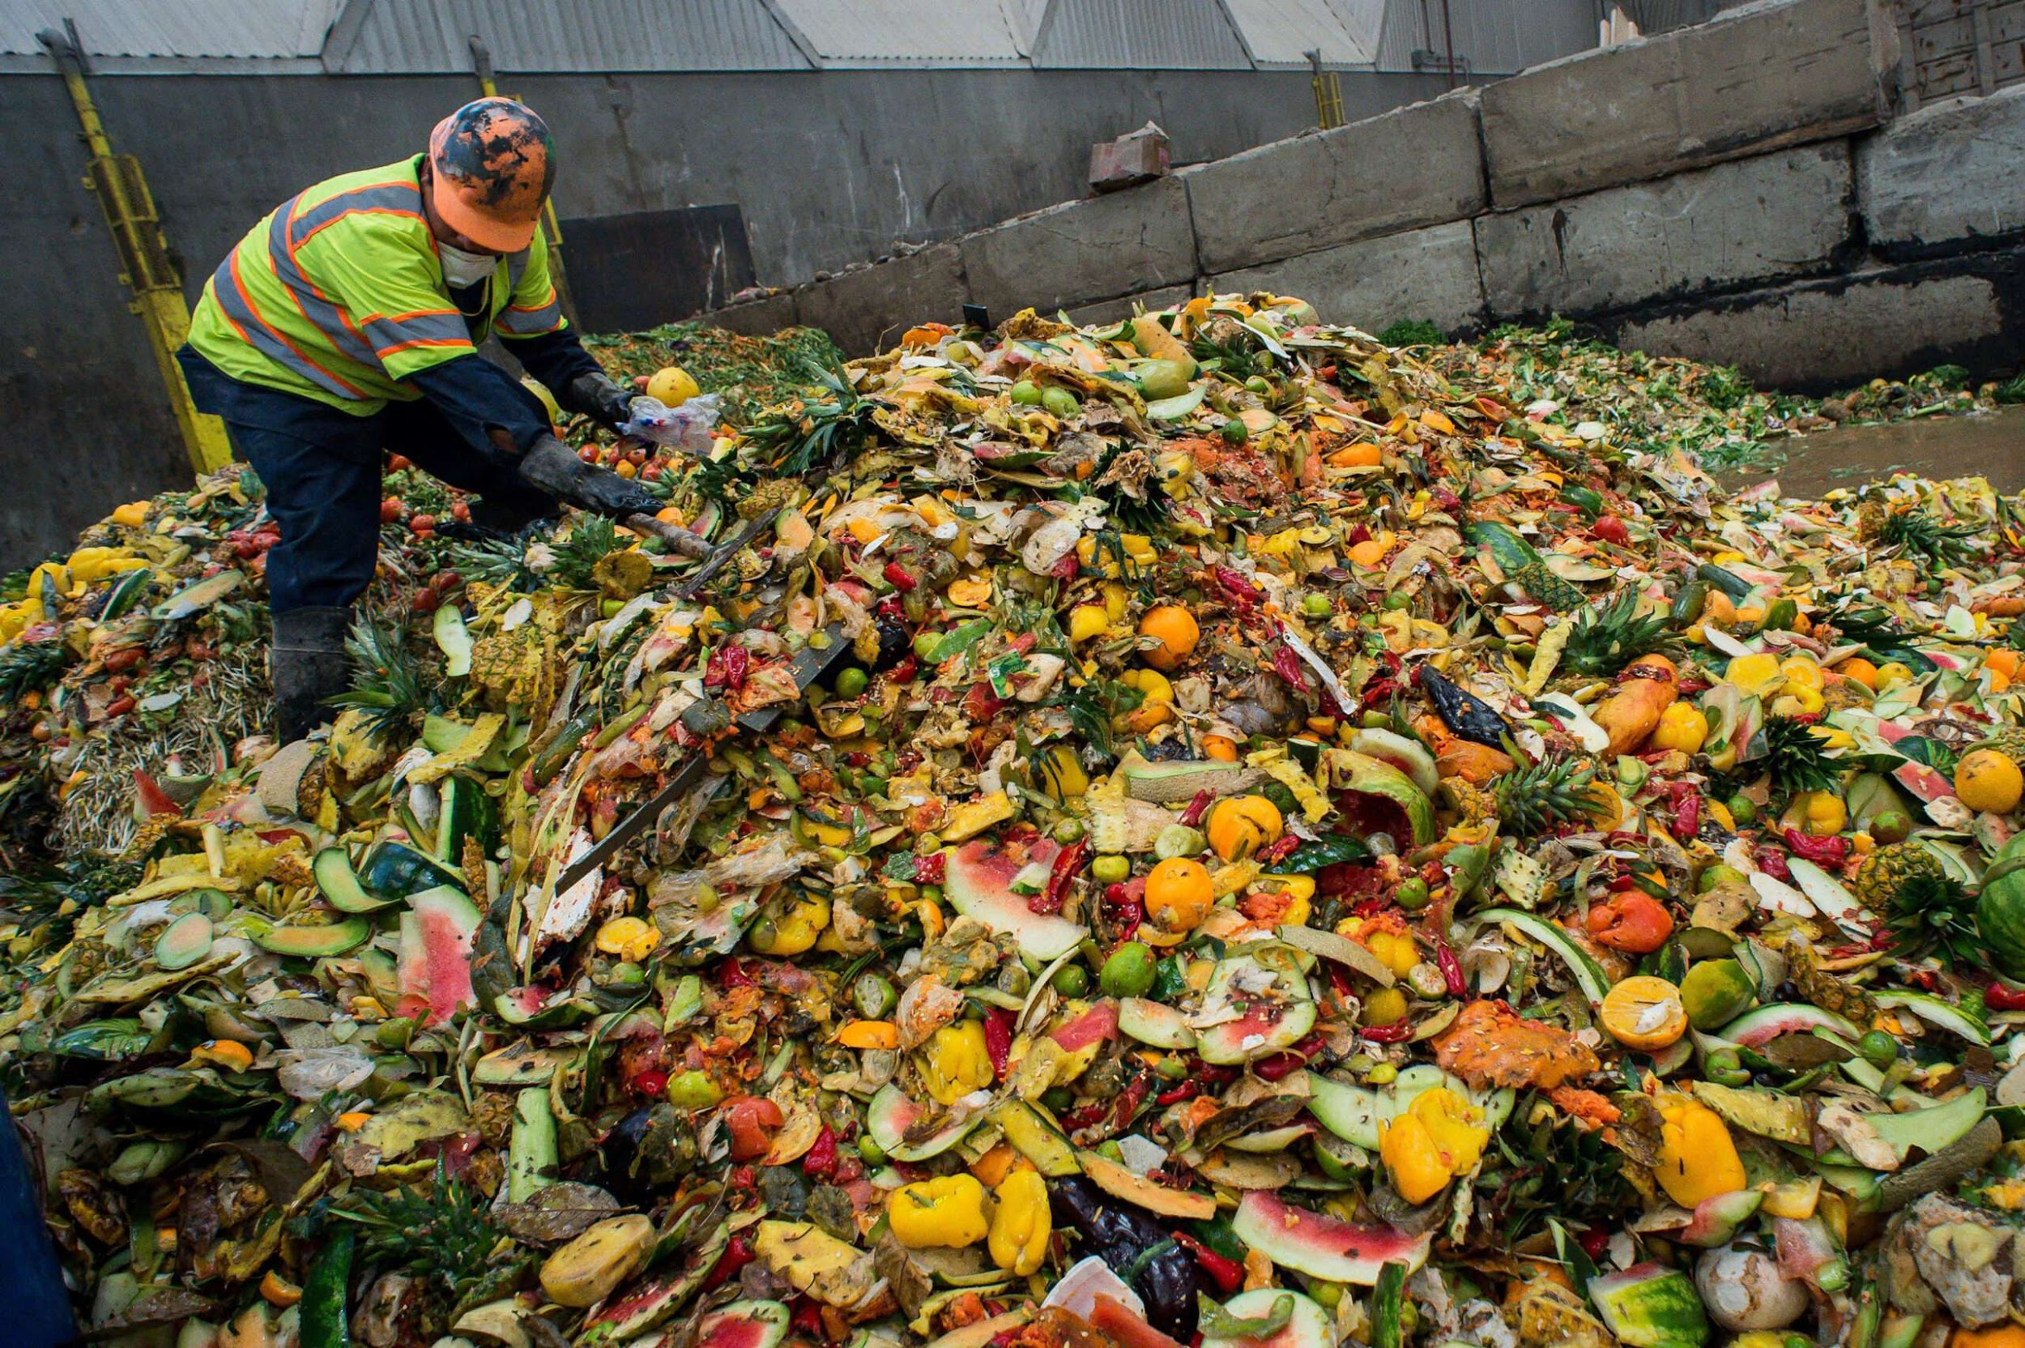
A PICTURE IS WORTH A THOUSAND WORDS

Slide 4
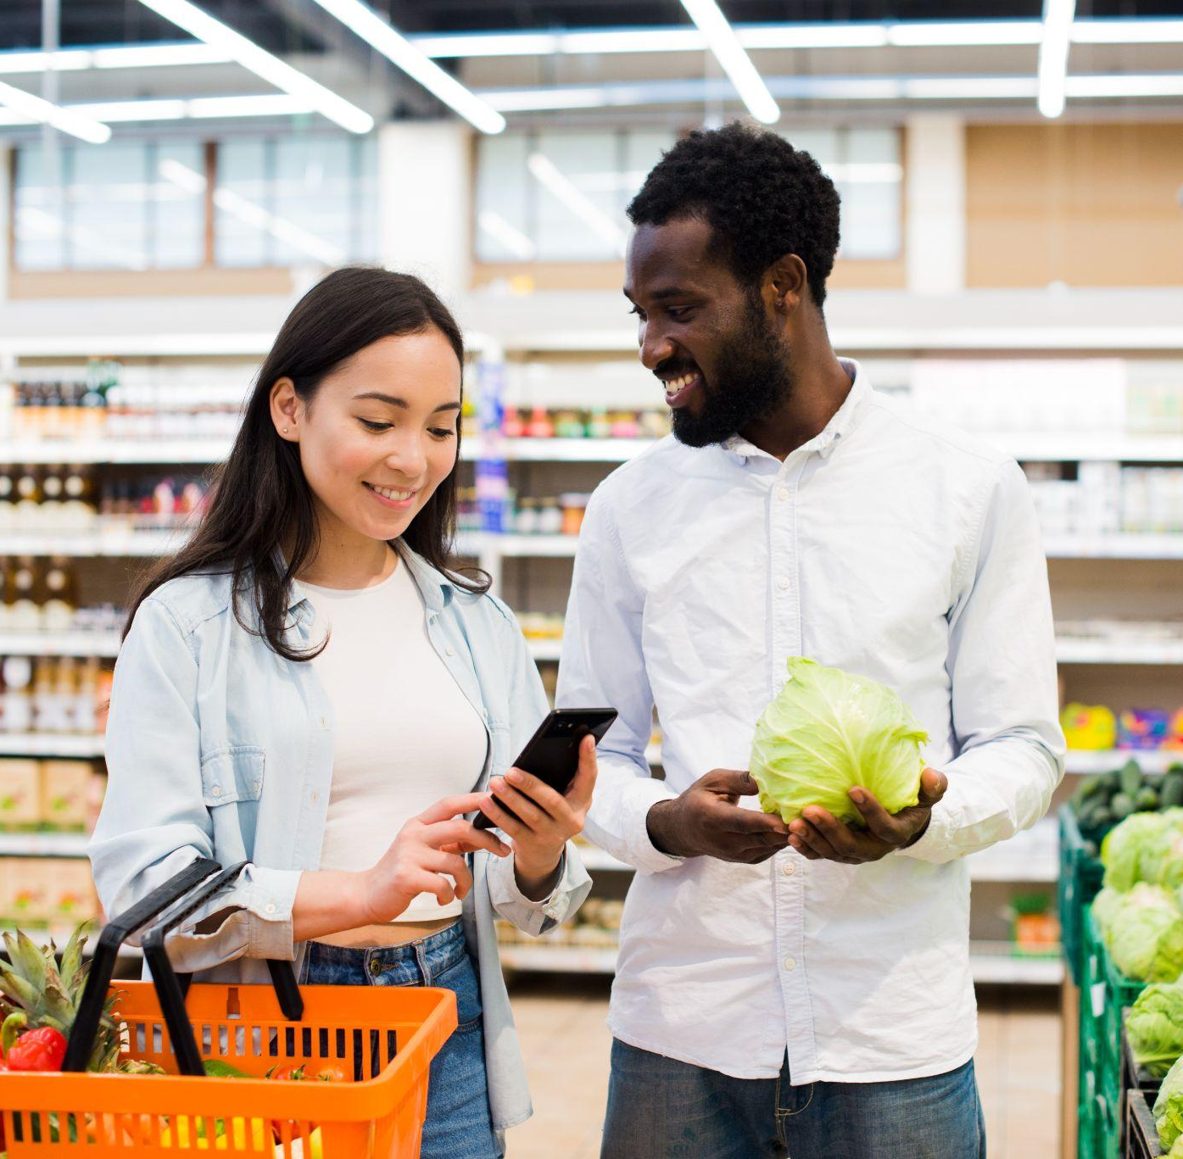
ABOUT OUR COMPANY
01
The app would connect users with local grocery stores and supermarkets that have a surplus of food that is close to its expiration date. These stores could then offer this food at a discounted price to the users of the app. Users can browse through the available deals and discounts on food items and make a purchase through the app. They would then be able to pick up their purchases at the store or have them delivered to their home.

Slide 5
The Problem
We want to make food waste a thing of the past. Food waste is not only a waste of money and resources, but also a major source of greenhouse gases that threaten our ozone layer. With our innovative tool, we can turn food waste into a valuable resource and reduce our environmental impact.

Slide 6
Our Goals
Fight against food waste.
Offer a specialized financial opportunity to people who can’t afford the standard price of a meal
Reducing the amount of people who dive into the trash searching for food.
Help markets profit from food that otherwise would not be put on display

Slide 7
How our Application
works
The Application will connects grocery stores with customers
The Application will have a management page for the grocery store manager
Customers can view the grocery deals around them
Customers will get notification from the application

Slide 8
How our Application works
The Application include a rewards program
The Application will be linked to other apps that can make suggestions of recipes
The application have a rating system for users where they can leave their feedback

Slide 9
How our Application works
The Application allows users to track their grocery items the expiration dates
The Application allows users to share surplus food with others in their community.

Slide 10
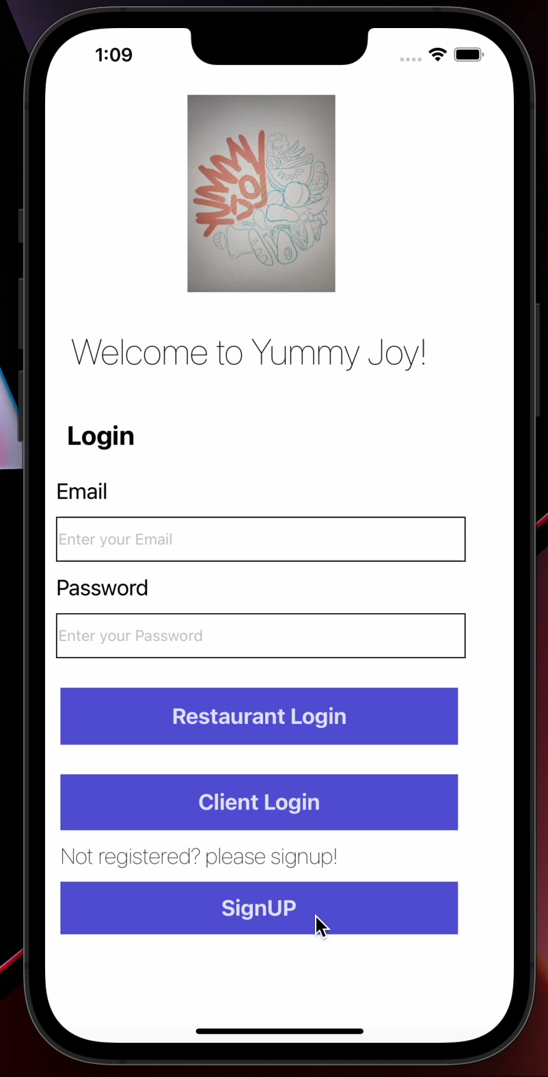

Slide 11



OUR PHILOSOPHY
Affordability
Reach
Reliable
We want to offer our clients a more affordable option in order for them to spend money elsewhere
We would like to reach the zones of Montreal where they experience high levels of poverty
Benefits for everybody. Our business will help local companies make profits instead of losing money with the food that they will throw away.

Slide 12
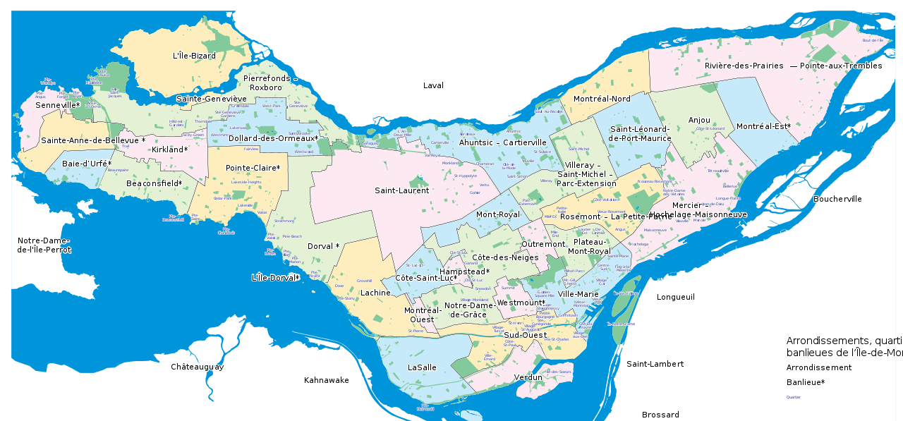
LOCATIONS

Slide 13
CUSTOMER PROFILE
Category | Application Users
Demographic | - People that have difficulties with buying groceries - people that care about the environment - Young adults
Purchasing Habits | Fruits, vegetables, milk, bread
Pain Points | -Cannot afford to buy expensive groceries. -Cannot live through the pain of Food waste
Communication Preferences | -Through the app chatbox
Customer Loyalty | - approximately 1 week (depends on customer needs)
Feedback and Reviews | - About the grocery stores - The price - The food quality

Slide 14
CUSTOMER PROFILE
Category | Grocery Store Owners
Demographic | - Local grocery stores around Montreal
Pain Points | -Not able to sell surplus food (goes to waste) -Losing money on surplus
Communication Preferences | -In Person -Email -phone
Customer Loyalty | - Contract agreement
Feedback and Reviews | - feedback about application

Slide 15
OUR Competitors
Similar apps, with a bigger scope
Food Hero: IGA and Metro.
Too good to go: Metro, Tim’s, Longos, Eataly, fresh city.
They are businesses that use applications to give people access to the products that the restaurants/supermarkets/bakeries would otherwise throw out.
They have very popular partners which makes their offering more desirable and causes more people to access the service now that they can get discounted products from their trusted places.

Slide 16
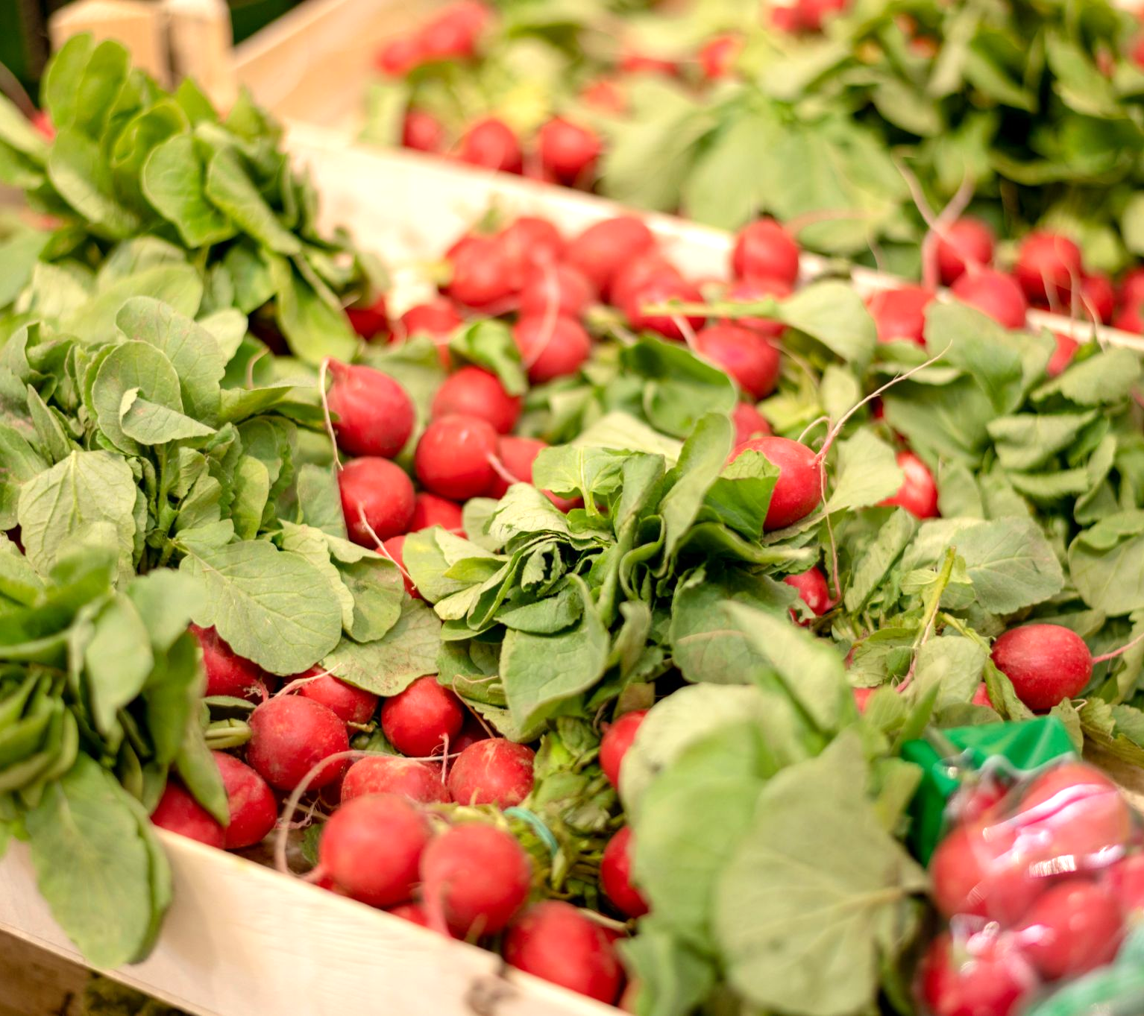
What We have More Than Our Competitors
FTX is simply best in the food recycling game. We
outdo our competitors because:
Our fruits and groceries are always in respectable quality
We have the cheapest prices!
We are more present locally
We have point reward system!
We offer bussiness insights on how much
food was saved and their impact
on the environment.
We offer personal suggestions based on purchase history to help save time and promote buisness.
And the most important thing:
We provide the best service to our customers

Slide 17
Market Validation
United States alone, nearly 30% of all food is thrown away
Only 2 other apps similar(food hero and too good to go)
Participate in local food events (feedback)

Slide 18
Adoption strategy
-Grow to more local business
-expand to different cities
-Monitor and improve food safety
-Enhance customer experience
-Start online presence

Slide 19
How do we make profit?
Ads
Subscription service
Commission 5% per purchase

Slide 20
OUR SERVICES
Connecting customers with local businesses
Allowing customers to view the establishment's current menu and prices
Helping local businesses profit from food that would otherwise be wasted
Helping people save money on groceries
Reducing the amount of food waste in our environment
Providing a platform for small grocery stores and existing stores to expand

Slide 21
OUR STRENGTHS
LOYALTY
EFFICIENCY
RELIABILITY
COMMITMENT
Supporting and improving local communities
The app functions as a simple mediator, that saves money and time
We have the higher standards
We're looking to constantly expand our reach so more people can benefit from our services

Slide 22
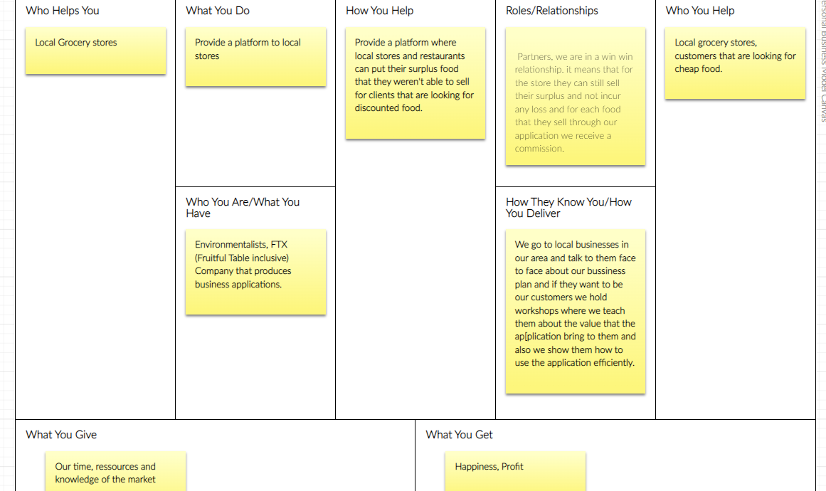
Business Model

Slide 23
“Think before you waste food: it may be a meal for someone else”.

